Slide 1
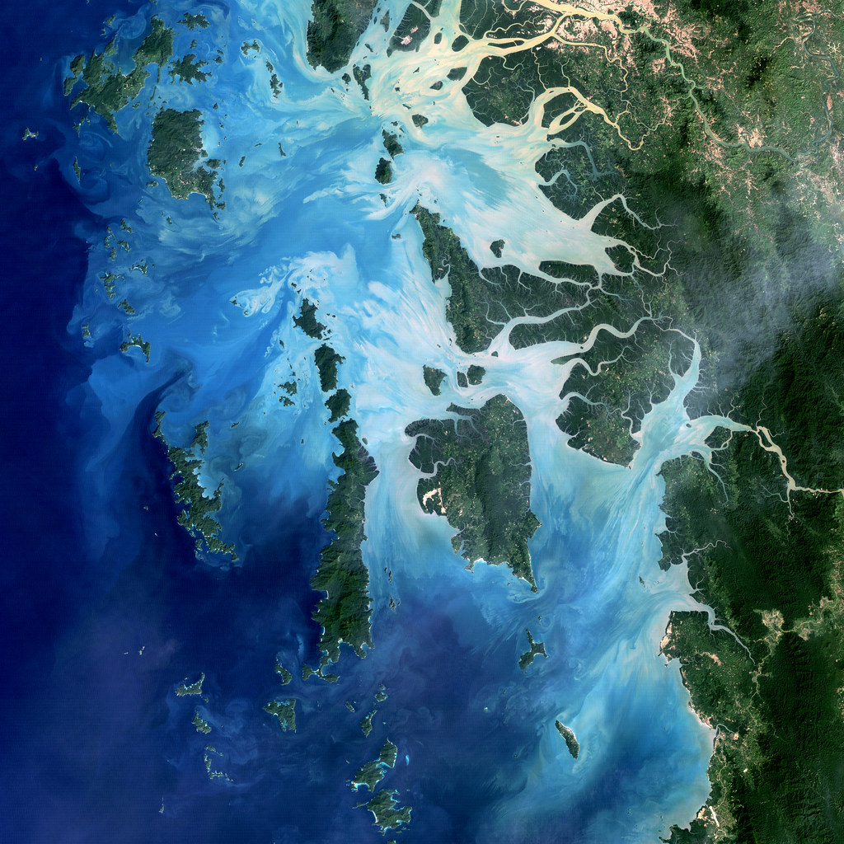
EVERYTHING STARTS WITH WATER
Team: Around The World
Dunca Denisa
Luncian Lidia
Darida Răzvan
Frișan Ionuț
This Photo by Unknown Author is licensed under CC BY

Slide 2


Objectives
Interactive application
Presents:
the water cycle in nature
how it is affected by climate change
Designed for elementary, middle or high school students
Use NASA satellite resources (SWOT, GMP, SMAP)

Slide 3

Solution
Scrollable page with all water cycle steps
Interactive ways of understanding information
Satellite images
Sliders to see the differences over years
Videos
Links to useful NASA resources
Quiz to test knowledge

Slide 4



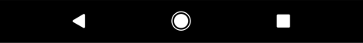
How does the site work?

Slide 5

NASA resources
NASA Climate Change Information
SWOT - Surface Water and Ocean Topography
GMP - Global Precipitation Measurement
SMAP - Soil Moisture Active Passive

Slide 6


Impact on students
Understanding the science behind climate change is the first step towards creating awareness.
Visual aids, interactive graphics, and videos on these sites help students grasp complex concepts easily.
The given information may fascinate them and bring them closer to the NASA world

Slide 7
Future work
Adding more quizzes and challenges for students
Adding relevant information and quizzes for different levels of knowledge (students)
Thinking of business approaches for the page
Adding other features like a chatbot that can answer student’s questions

